Slide 1
Patient Amenities

Slide 2
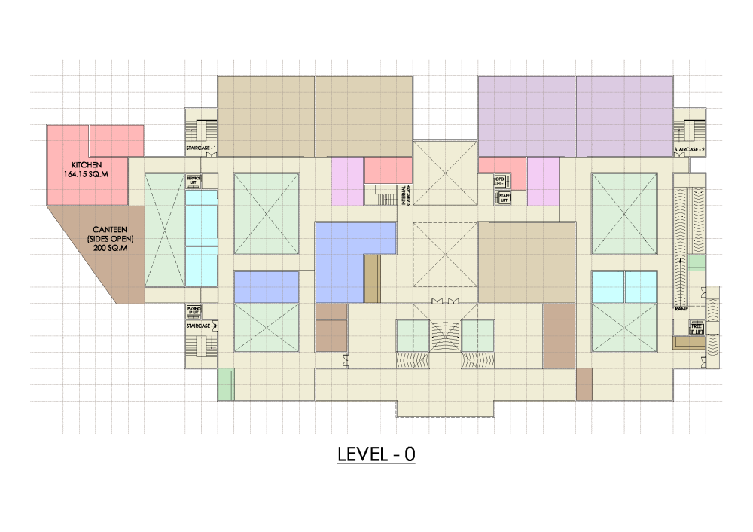

CANTEEN:
Isolated from the hospital block
Accessed from the outside
Can be used as a pre waiting
Connected both from paying OP & IP at level 0
CANTEEN

Slide 3
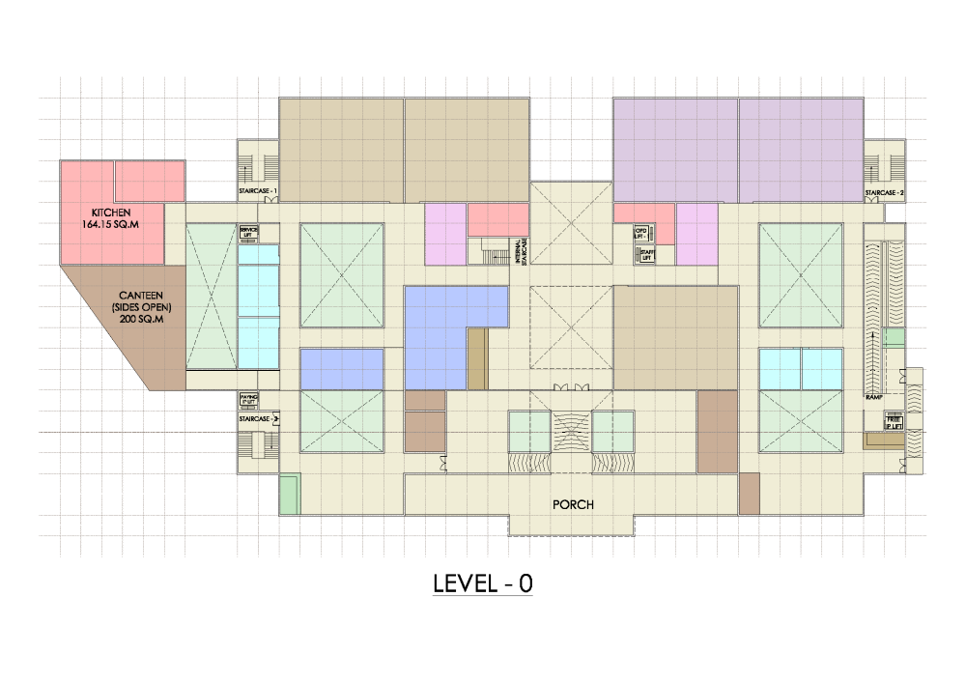
PORCH / DROP OFF:
Common for both OP & IP entrances
Gives a centralised entry for the users
Easy to control the movement of patients
FREE IP
ENTRY
PAYING OP
ENTRY
PAYING IP
ENTRY
FREE OP
ENTRY
PORCH / DROP OFF

Slide 4

Pre-waiting area
Waiting space is created outside the entrance
Used by the patients coming before the registration opens
Canteen can also be used as a pre waiting space
PRE-WAITING AREA

Slide 5
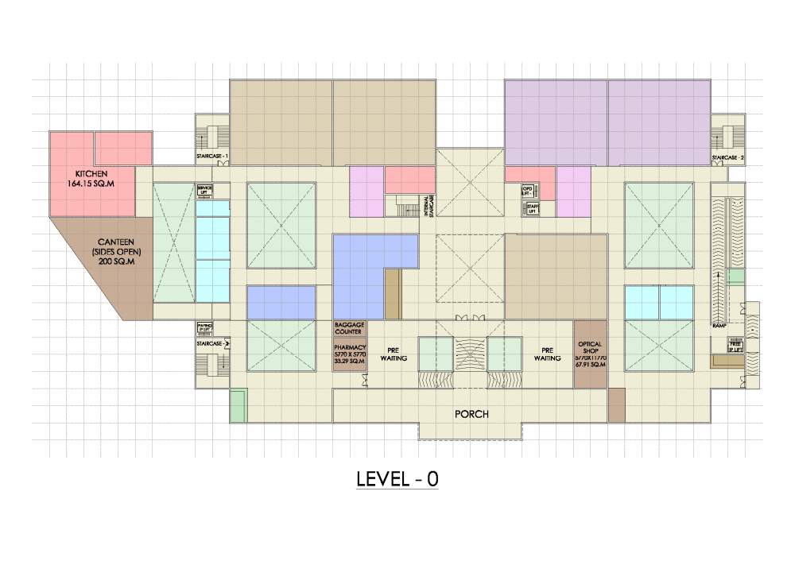
Optical Shop, Pharmacy & Baggage:
Located near the entrance
Easy visibility
Easy accessibility
OPTICAL SHOP, PHARMACY AND BAGGAGE

